Slide 1
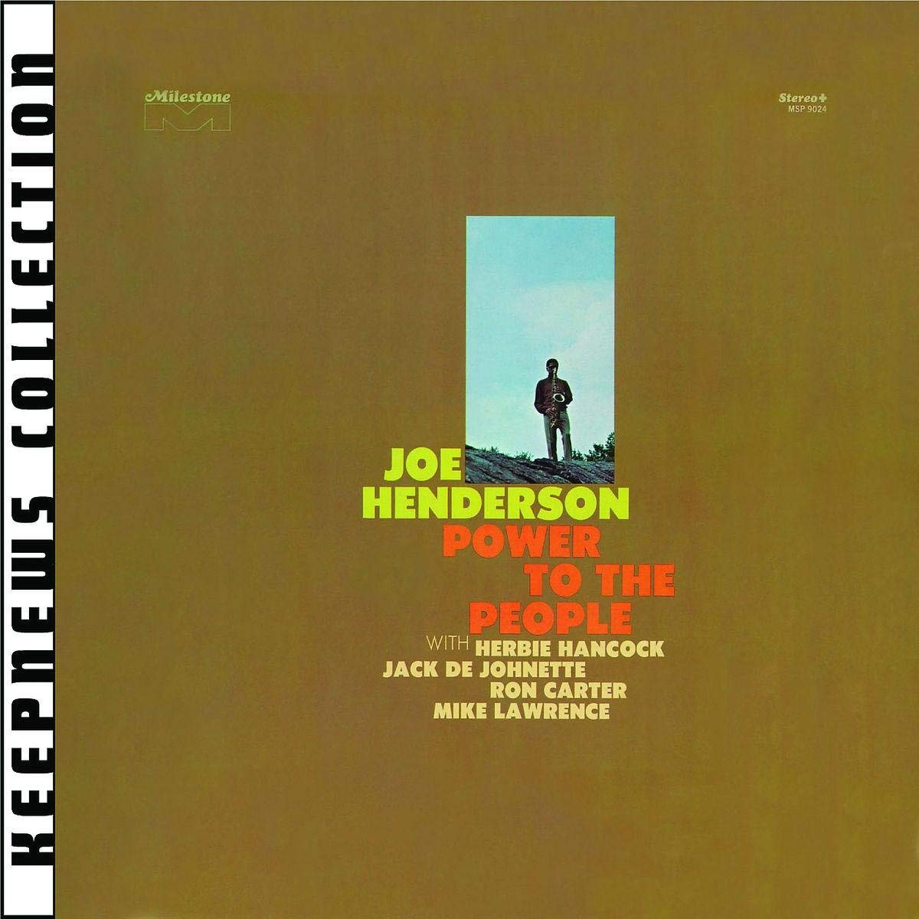
Power to the People
Joe Henderson, 1969
Peter Howarth

Slide 2
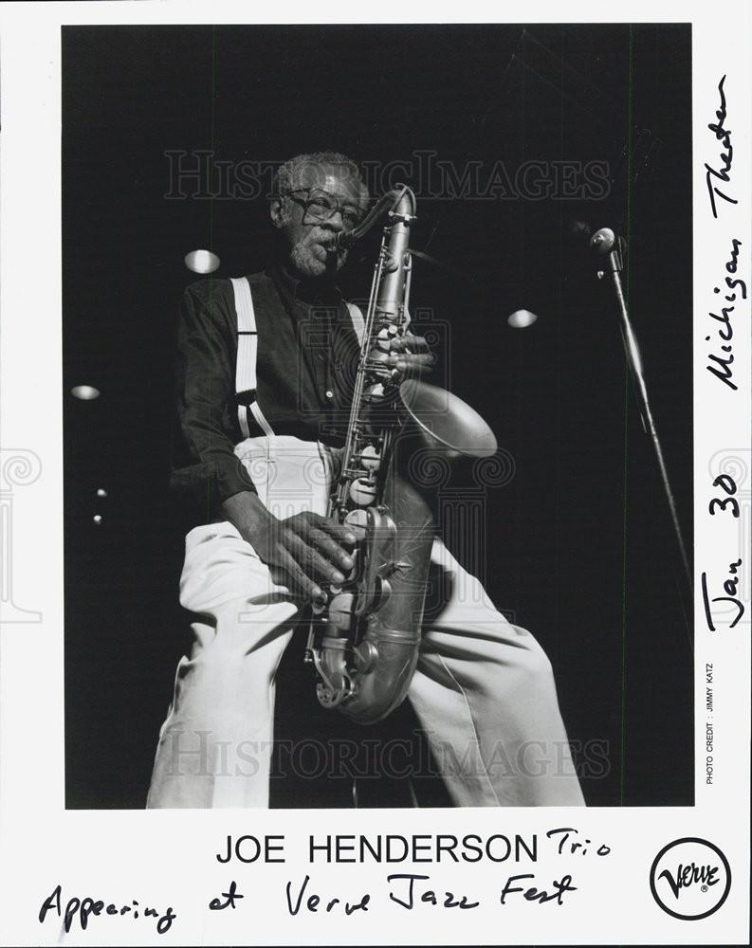
Background on Joe (1937-2001)
From Lima, Ohio
Encouraged by his parents and brother to study music
Early musical interests included drums, piano, saxophone and composition
Spent two years in US Army (1960-62)
Upon discharge, moved to New York
Most known for records with Blue Note from 1963-68
Also appeared on other significant records for record label
Horace Silver’s Song for My Father
Herbie Hancock’s The Prisoner

Slide 3
The Album
Musicians:
Joe Henderson: tenor sax
Mike Lawrence: trumpet
Herbie Hancock: piano, electric piano
Ron Carter: bass, electric bass
Jack DeJohnette: drums
Track List:
Black Narcissus
Afro-Centric
Opus One-Point-Five
Isotope
Power to the People
Lazy Afternoon
Foresight and Afterthought (An Impromptu Suite in Three Movements

Slide 4
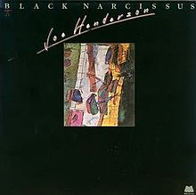
Black Narcissus (2:05 - 2:42)
shift in tonal centers, from Amin7 to Cmin7
use of the Dorian Mode
smoother, more reserved
title of a future album
Afro-Centric (5:15 - 5:55)
Hancock’s solo highlights the track
prominent usage of trumpet

Slide 5
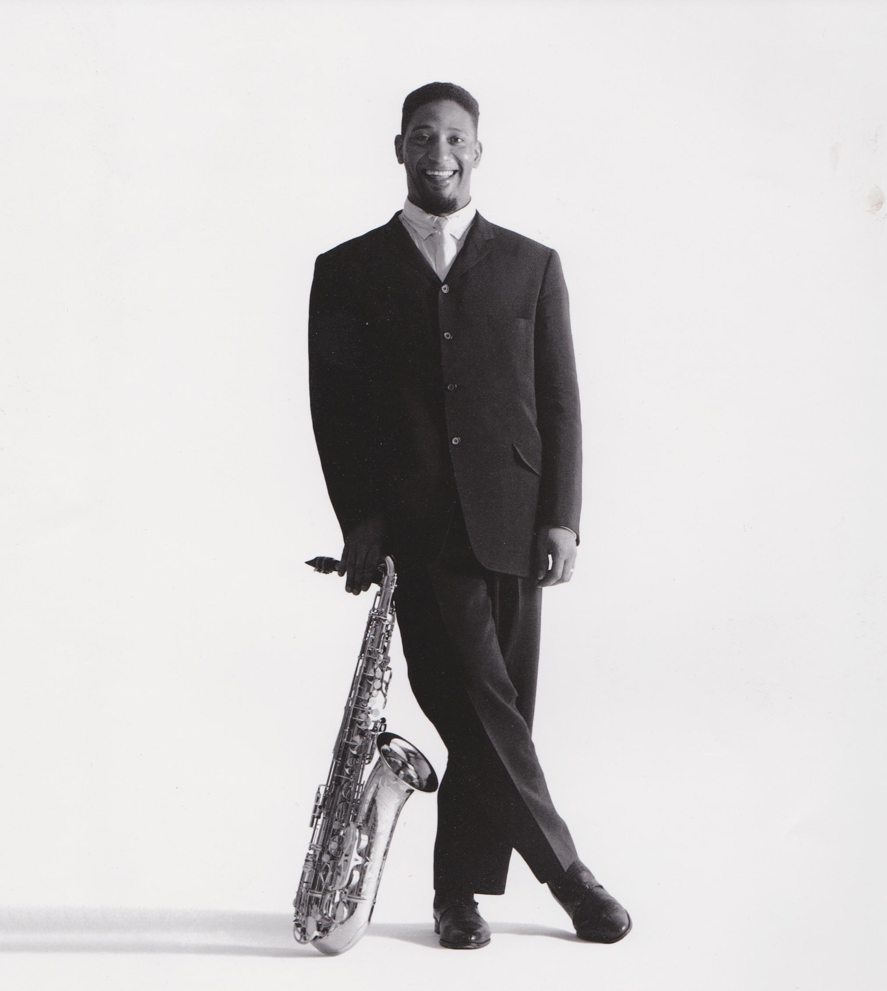
Opus One-Point-Five (3:30 - 3:51)
completely acoustic
lots of tonal shifts
Isotope (2:39 - 3:18)
straight bop, shows influence from Sonny Rollins
included in widely-acclaimed The State of the Tenor

Slide 6
Power to the People (0:46 - 1:23)
similar in style to “Afro-Centric”
more urgent-sounding
a cry for change
Lazy Afternoon (0:59 - 1:36)
a standard, the only featured on the album
lots of interplay between Hancock and Henderson

Slide 7
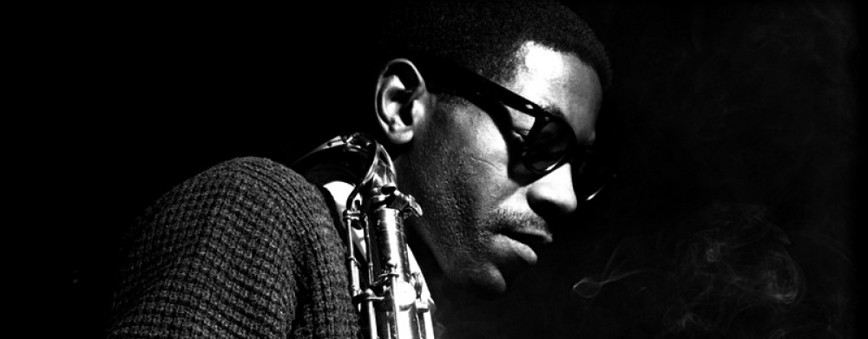
Foresight and Afterthought (An Impromptu Suite in Three Movements) (2:34 - 3:20)
as indicated by the title, completely improvised
foreshadowed Henderson’s following work, being pianoless
future work was without chordal instruments
irrevency due to improvisation
lots of emotion

Slide 8
Discussion Questions
Why do you think Henderson may not be as well known as his contemporaries such as Herbie Hancock and Miles Davis
How does the diversity in styles represented in this album display the message behind this album?
What’s your favorite track and why?

Slide 9
Sources
https://www.amazon.com/Power-People-Joe-Henderson/dp/B000NJL08E
https://outlet.historicimages.com/products/mva30143
http://sonnyrollins.com/biography/
https://en.wikipedia.org/wiki/Joe_Henderson
https://www.npr.org/templates/story/story.php?storyId=9804738
https://libres.uncg.edu/ir/uncg/f/umi-uncg-1618.pdf
https://en.wikipedia.org/wiki/Power_to_the_People_(Joe_Henderson_album)
https://en.wikipedia.org/wiki/Black_Narcissus_(Joe_Henderson_album)

