Slide 1
Strategies for Introducing Jazz Improv to Your Students
Professor Earl MacDonald Director of Jazz Studies

Slide 2
Fear of Improvising

Slide 3
Call and Response

Slide 4
Major Pentatonic Scale 1, 2, 3, 5, 6
One measure phrase
Two measure phrases
Then….
THEY LEAD!!!

Slide 5
the Blues Scale 1, ^{b}3, 4, #4, 5, ^{b}7, 8 C, E^{b}, F, F#, G, B^{b}, C
One measure phrase
Two measure phrases
Then….
THEY LEAD!!!

Slide 6
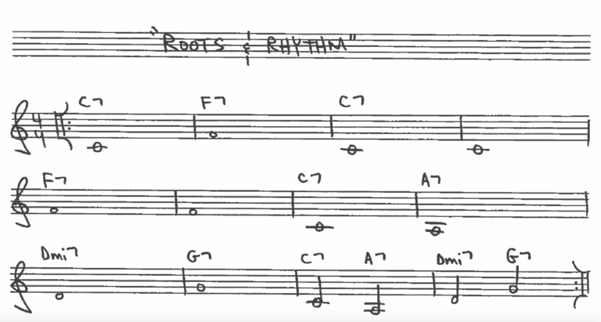
Roots

Slide 7
Rhythm

Slide 8
Roots and Rhythm

Slide 9
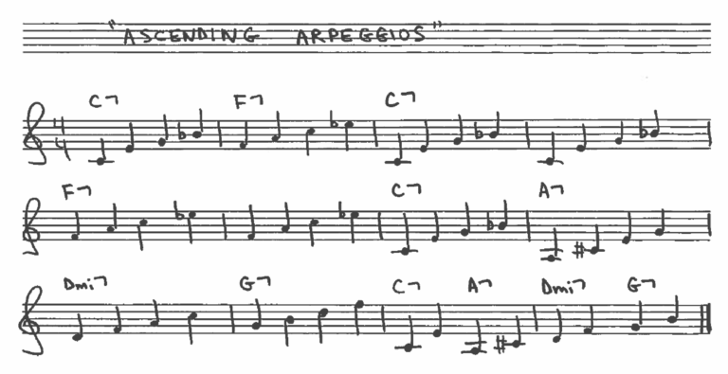
Arpeggiating the Blues

Slide 10
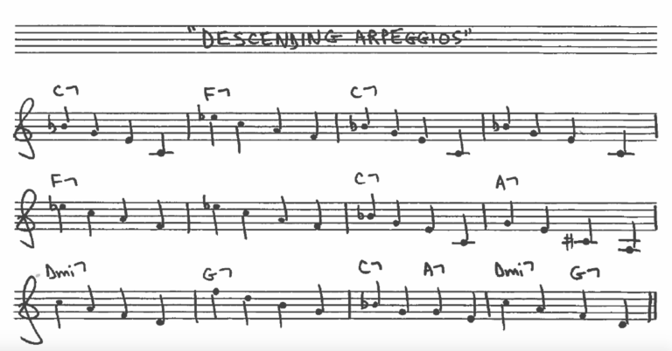
Descending Arpeggios

Slide 11
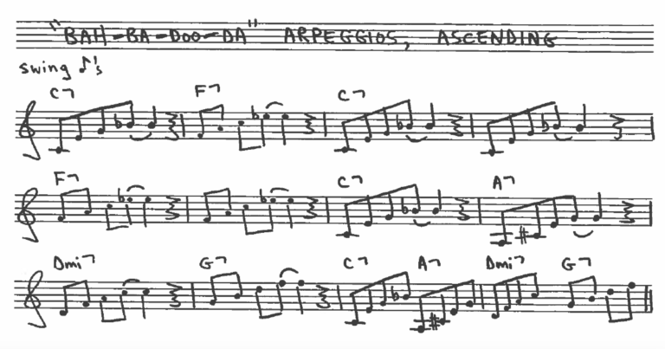
Bah-ba-doo-dah Arpeggios

Slide 12
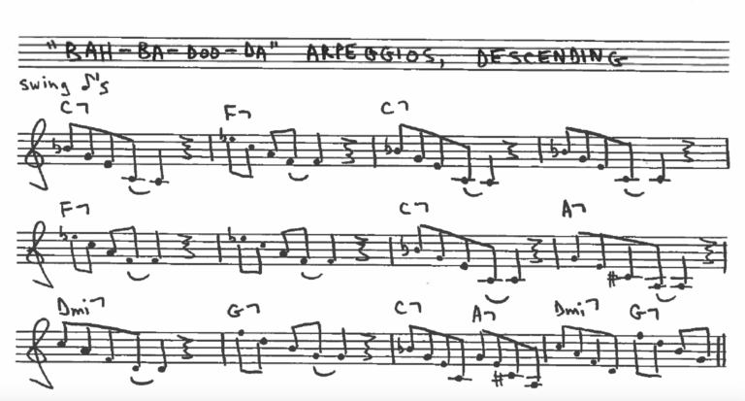
Bah-ba-doo-dah, descending

Slide 13
Chord Tone Patterns
ANY combinations of the 1-3-5-7 chord tones:
1357, 1375, 1537, 1573, 1735, 1753, 3157, 3175, 3517, 3571, 3715, 3751, 5137, 5173, 5317, 5371, 5713, 5731, 7135, 7153, 7315, 7351, 7531, 7513
Am I missing any?!

Slide 14
3 – 5 – 1 - 7

Slide 15
3 – 5 – 1 – 7, swung

Slide 16
the Blues Scale 1, ^{b}3, 4, #4, 5, ^{b}7, 8
One measure phrase
Two measure phrases
Then….
THEY LEAD!!!

Slide 17
Trading 4s
Trading Choruses

Slide 18
Half Note, Chord Tone Improv

Slide 19
Middle School Combo
“the Jazz Messenger Pigeons”

Slide 20
Beginner Combo Repertoire
Jamey Aebersold’s Jazz “Play-A-Long” Series
Vol. 54, “Maiden Voyage”
Bb Blues
Impressions (So What)
Song For My Father
Doxy
Blue Bossa (“Solar Flair”)

Slide 21
http://www.earlmacdonald.com/

