Slide 1

Rhythm Section Techniques and Solutions
Professor Earl MacDonald
Director of Jazz Studies

Slide 2
dissimilarities
learning approach
strengths/weaknesses
notation
drawing upon one’s collective listening

Slide 3

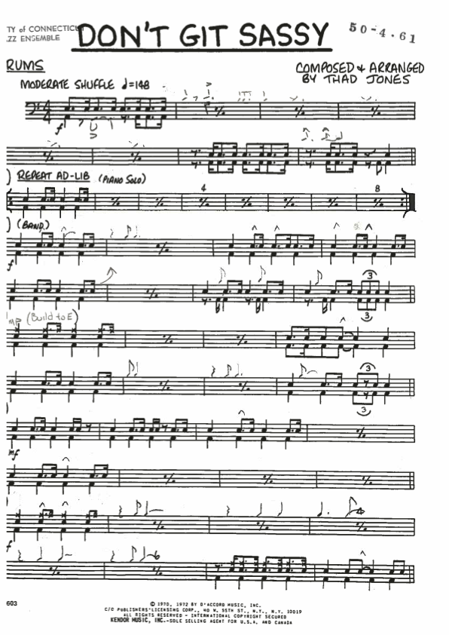

Slide 4
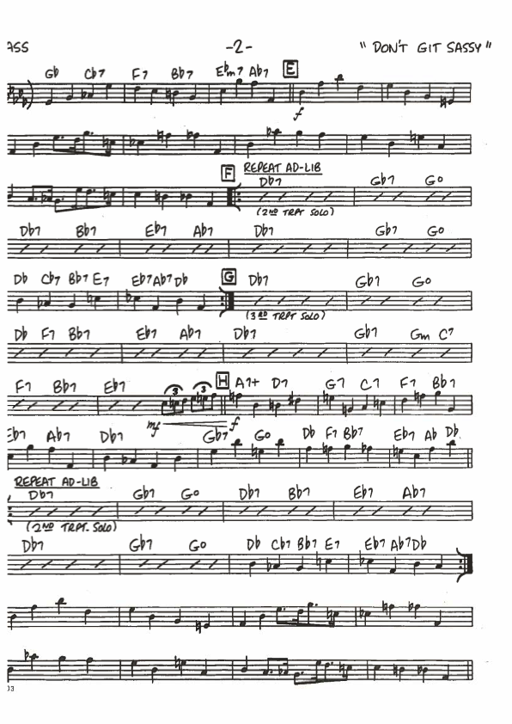

Slide 5
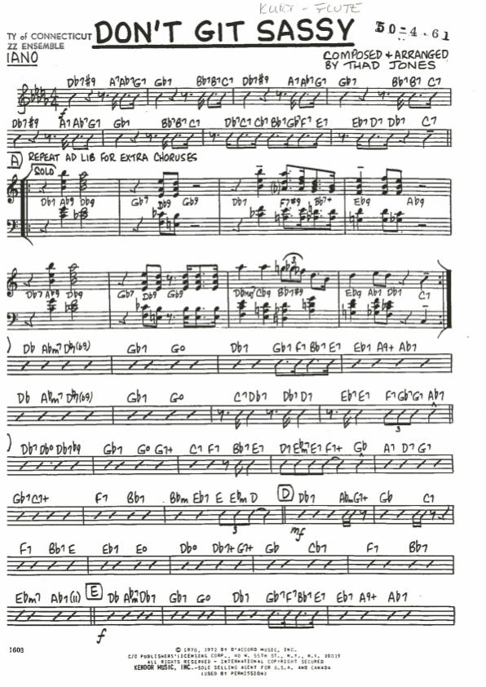

Slide 6
Book Recommendations
Drums:
    Advanced Techniques for the Modern Drummer, by Jim Chapin
    The Art of Bebop Drumming, by John Riley
Bass:
    The Jazz Bass Line Book, by Mike Downes
    The Improvisor's Bass Method, by Chuck Sher
Piano:
    The Jazz Piano Book, by Mark Levine
    Voicings for Jazz Keyboard, by Frank Mantooth

Slide 7
rhythm section set-up configurations

Slide 8
Guitar & Piano
Specific Roles:
  taking turns comping
  dominant and subservient functions
  rhythmic vs. sparse colors
  Freddie Green & Count Basie
  assigning melodic lines

Slide 9
Walking Bass Line Construction
1, 1, 5, 1
1, 5, 8, 5
8, 5, 1, 5
1, 5, 8, “approach”
* LONG, connected quarter notes.

Slide 10
Drums: common infractions
feathering the bass drum
ride cymbal pattern
setting up ensemble passages
left hand, snare drum independence and comping
eye contact and partnership

Slide 11
Piano Accompaniment in a jazz context
(a.k.a. “comping”)
Voicings
Rhythm

Slide 12
www.earlmacdonald.com

Slide 13
Pianists
Art Tatum, Nat Cole, Oscar Peterson, Duke Ellington, Count Basie, Bud Powell, Thelonious Monk, Barry Harris, Hank Jones, Cedar Walton, Tommy Flanagan, Sonny Clark, Red Garland, Ahmad Jamal, Wynton Kelly, Horace Silver, Lennie Tristano, Bill Evans, Phineas Newborn, George Shearing, John Hicks, Harold Mabern, Kenny Drew, Herbie Hancock, McCoy Tyner, Kenny Barron, Chick Corea, Keith Jarrett, Joe Zawinul, Mulgrew Miller, Richie Beirach, Fred Hersch, Eddie Palmieri, Paul Bley, Kenny Kirkland.

Slide 14
Guitarists
Charlie Christian, Charlie Byrd, Barney Kessel, Grant Green, Freddie Green, Wes Montgomery, Kenny Burrell, Jim Hall, Tal Farlow, Herb Ellis, Les Paul, Django Reinhardt, Jimmy Raney, Joe Pass, John Scofield, Mike Stern, Wayne Krantz, Bill Frisell, Ben Monder, Robin Eubanks, John Abercrombie, Larry Corryell, Pat Metheny, Ed Bickert, Mick Goodrick, Ralph Towner

Slide 15
Bassists
Oscar Pettiford, Paul Chambers, Ray Brown, Ron Carter, Dave Holland, Butch Warren, Sam Jones, Buster Williams, Richard Davis, Jimmy Garrison, Steve Davis, Reggie Workman, Wilbur Ware, Doug Watkins, Sam Jones, Charles Mingus, Bob Cranshaw, Scott LaFaro, Eddie Gomez, Marc Johnson, Rufus Reid, Charles Fambrough, Niels-Henning Ortsed-Pederson, Charlie Haden, Ray Drummond, Christian McBride

Slide 16
Drummers
Papa Jo Jones, Kenny Clarke, Max Roach, Art Blakey, Arthur Taylor, “Philly” Joe Jones, Elvin Jones, Jimmy Cobb, Tony Williams, Roy Haynes, Billy Higgins, Danny Richmond, Al Foster, Mel Lewis, Ralph Peterson, Jon Christensen, Victor Lewis, Louis Hayes, Jack DeJohnette, Joe Chambers, Carl Allen, Vernell Fournier, Adam Nussbaum, Steve Gadd, Jeff Watts, Brian Blade, Rudy Royston

Slide 17
Rhythm Section Techniques and Solutions
Professor Earl MacDonald
Director of Jazz Studies

