Slide 1
The Cycle by Earl MacDonald
No! Not that kind of cycle!

Slide 2
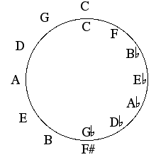

Slide 3
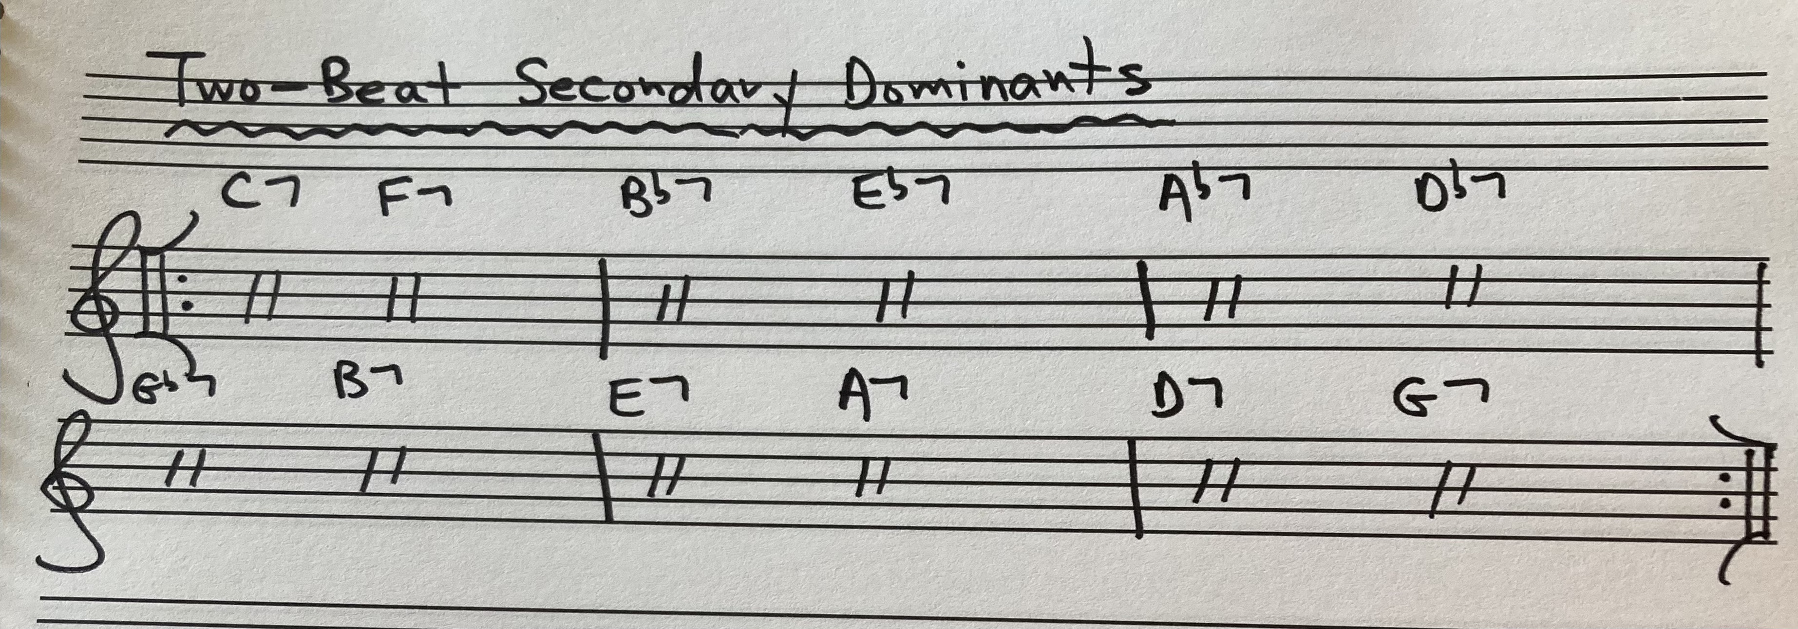

Slide 4
Jordu by Duke Jordan
https://youtu.be/GslhRUBgXNI

Slide 5
2-Beat Patterns

Slide 6
Funk In Deep Freeze by Hank Mobley
https://youtu.be/0-8MCGMAO0k

Slide 7
Superimposition - Rhythm Changes -
Rhythm-a-ning
Mulligan Meets Monk
Monk’s Solo:
https://youtu.be/LSLXtncJIrw
Turnpike JJ Johnson’s “The Eminent JJ Johnson, vol. 1 2nd chorus of Clifford Brown
2nd chorus of Jimmy Heath
2nd chorus of JJ Johnson
2nd chorus of John Lewis
https://youtu.be/f9YGsKYWiGI

Slide 8
Superimposition - Blues -

Slide 9
Two Bass Hit by Miles Davis
Two Bass Hit, from Miles Davis’ Milestones:
https://youtu.be/ZiABp0Px2WY
Cannonball Adderley’s solo
John Coltrane’s solo

